Slide 1

MySQL Enterprise Edition JavaScript stored programming
Webinar du 20 Mai 2025
Emmanuel COLUSSI
MySQL Solution Architect EMEA
Oracle MySQL GBU

Slide 2

Speaker
Presentation Title
Emmanuel COLUSSI
MySQL Solution Architect EMEA

Slide 3
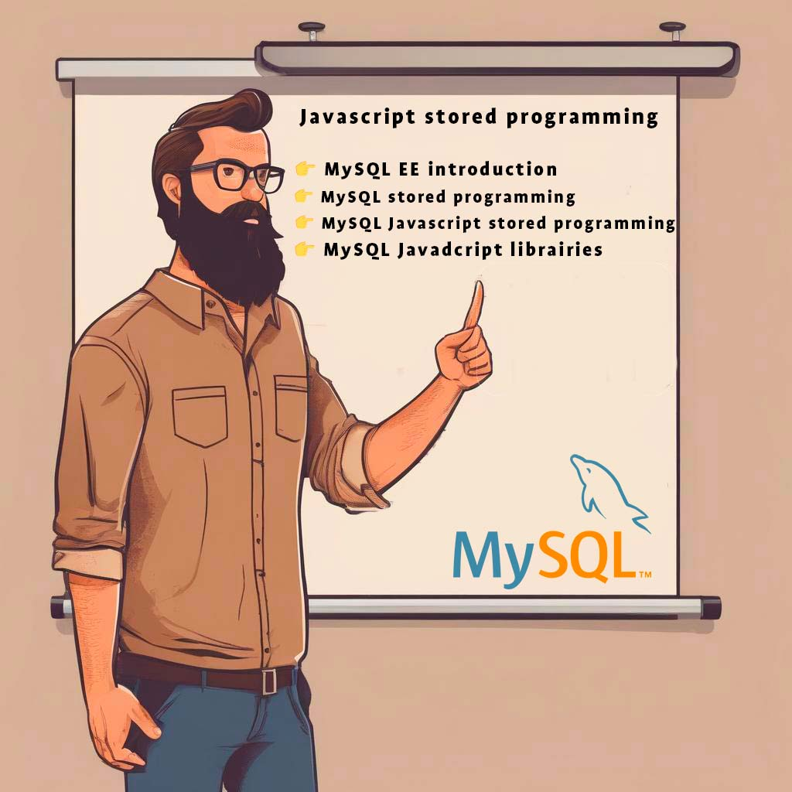

Agenda
👉 MySQL EE introduction
👉 MySQL SQL stored programming
👉 MySQL JavaScript stored programming
👉 MySQL JavaScript libraries

Slide 4
MySQL Enterprise

Slide 5






MySQL Community VS MySQL Enterprise
1
2
3
MySQL Security
MySQL Scalability
MySQL HA DR
4
5
6
MySQL Stored Programs
MySQL Monitoring
MySQL 24x7
Support
MySQL Community

Slide 6
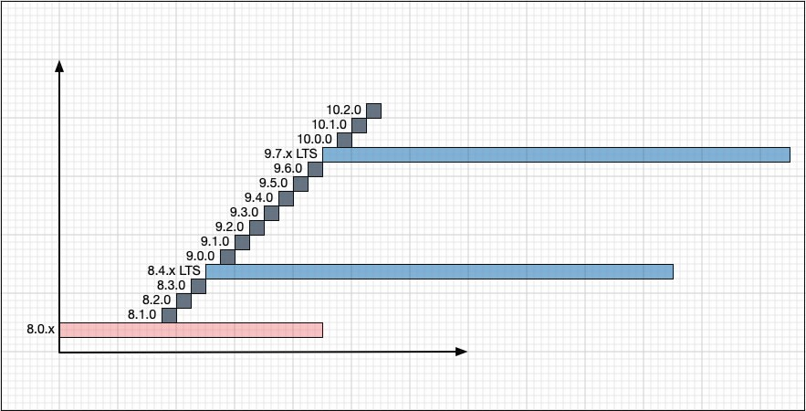
NEW: MySQL LTS & Innovation Releases
MySQL Community and Enterprise
Innovation releases (grey)
Long Term Support (blue)
Note: Numbering in the slide is an example and may change
MySQL Long-Term Support (LTS) Releases
bugfix & security patches only
backwards compatibility
support lifecycle: 5y premier + 3y extended
Include tools (like MySQL Shell)
MySQL Innovation Releases
leading-edge innovations
will likely released every quarter
Include tools (like MySQL Shell)
Connectors released as Innovation only

Slide 7
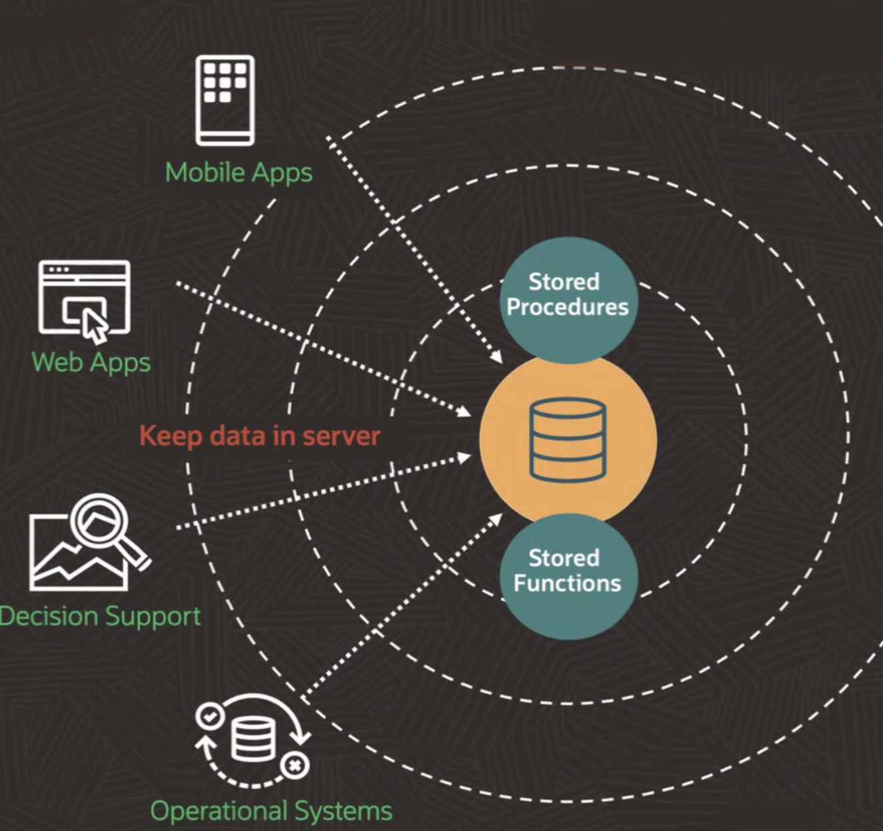
MySQL Enterprise Stored Programs: Keep Data in MySQL
Stored Programs : Lower costs, reduces complexity, and improves security
Execute JavaScript Stored Procedures and
Stored Functions via GraalVM
Handle data-intensive app functionality
in stored programs
• Minimize data movement
• Reduce cost
• Improve Security
• Simplify complex ETL → ELT

Slide 8

MySQL SQL stored programming

Slide 9
MySQL stored routines
A stored routine is a reusable set of SQL or JavaScript statements stored on the server
Clients invoke the routine instead of sending individual statements repeatedly
Stored Procedures
Created using CREATE PROCEDURE, invoked with CALL
No return value, but can modify parameters for output
Can generate result sets for client consumption
Stored Functions
Created using CREATE FUNCTION, used like built-in functions
Invoked in expressions and return a value
Associated with a specific database
SQL stored functions cannot be recursive
Recursion Rules
SQL stored procedures can be recursive, but recursion is disabled by default (max_sp_recursion_depth)
JavaScript stored routines support recursion
Default maximum depth: 1000

Slide 10
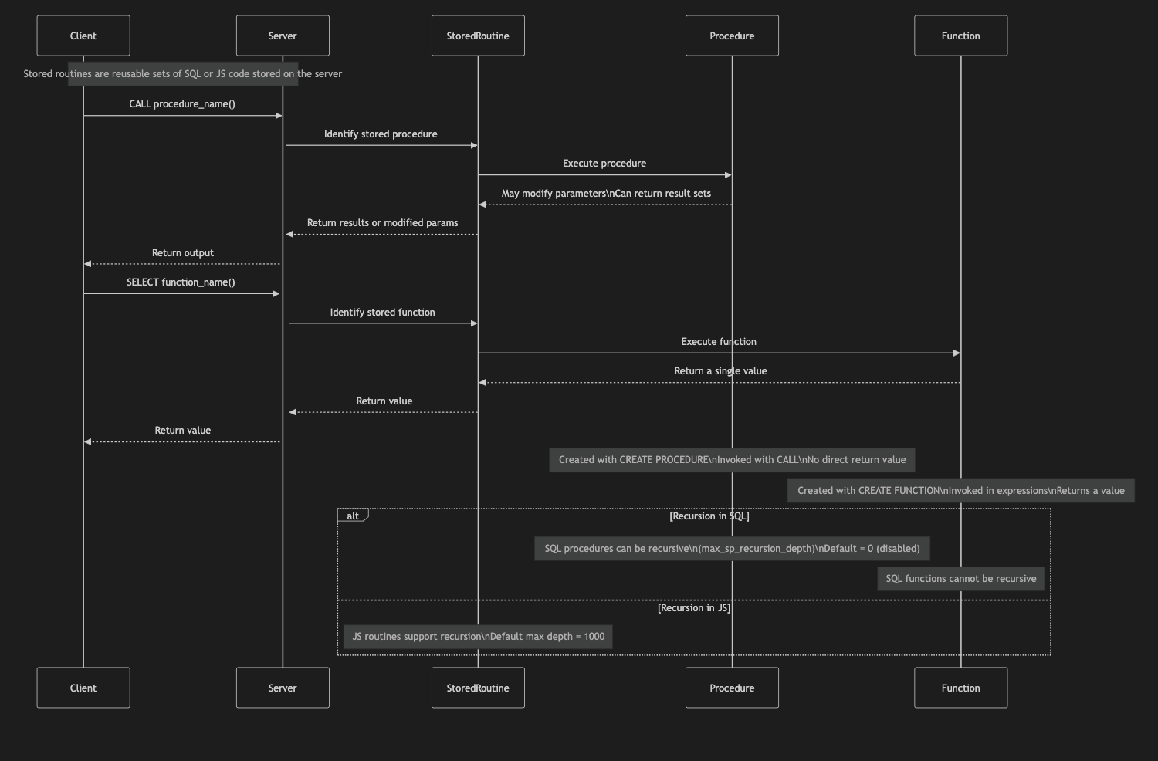
MySQL stored routines
Flow

Slide 11
Stored procedure security
There are specific privileges for routines
CREATE ROUTINE, ALTER ROUTINE, EXECUTE
SQL SECURITY define the scope of the stored object
If a definition omits the DEFINER attribute, the default object definer is the user who creates it
SQL SECURITY DEFINER to execute in definer security context
let other users to execute the command without the privilege on referenced objects
SQL SECURITY INVOKER to execute in invoker security context
let other users to execute the command only on objects where they have the privilege

Slide 12

Uses of Stored Routines
Extend functions available to clients
Centralized client functionality
Create a routine in MySQL and make it available to multiple clients
Simplified maintenance
Improved security
Create automations
Used for triggers
Used from event scheduler
Security
Minimize data access, executing with DEFINER privileges
Single location processing

Slide 13
SQL stored procedure example
mysql> delimiter //
mysql> CREATE PROCEDURE citycount (IN country CHAR(3), OUT cities INT)
BEGIN
SELECT COUNT(*) INTO cities FROM world.city WHERE CountryCode = country;
END//
Query OK, 0 rows affected (0.01 sec)
mysql> delimiter ;
mysql> CALL citycount('JPN', @cities); -- cities in Japan
Query OK, 1 row affected (0.00 sec)
mysql> SELECT @cities;
+---------+
| @cities |
+---------+
| 248 |
+---------+
1 row in set (0.00 sec)

Slide 14
SQL stored function example
mysql> delimiter //
mysql> CREATE FUNCTION hello (s CHAR(20)) RETURNS CHAR(50) DETERMINISTIC
BEGIN
RETURN CONCAT('Hello, ',s,'!');
END//
Query OK, 0 rows affected (0.00 sec)
mysql> delimiter ;
mysql> SELECT hello('world');
+----------------+
| hello('world') |
+----------------+
| Hello, world! |
+----------------+
1 row in set (0.00 sec)

Slide 15
Stored Routine Metadata
Query the ROUTINES table in the INFORMATION_SCHEMA database
Use SHOW CREATE PROCEDURE and SHOW CREATE FUNCTION to view routine definitions
Use SHOW PROCEDURE STATUS and SHOW FUNCTION STATUS to examine routine characteristics
Up to MySQL 8.4: Stored routines are SQL-only
Refer to the manual for details on variables and flow control
From MySQL 9.0 onwards: JavaScript support is available
Starting with MySQL 9.2: Create libraries to enhance routine reusability

Slide 16
Javascript support inside MySQL
ECMAScript 2023 Compliant
Runs in strict mode by default
Supports standard built-in objects: Object, Function, Math, Date, String, etc.
Scoped Execution Environment
“global” and “globalThis” are supported but scoped to the current routine
No access to filesystem or network from JavaScript code
Node.js is not supported
Execution Model
Single-threaded per query
Async features (Promise, async/await) are simulated – may show non-deterministic behavior
Interop with SQL
Call SQL stored programs from JavaScript
JavaScript routines can be invoked from SQL procedures, functions, events, and triggers
Supports recursion up to 1000 levels
Developer Convenience
No need to change DELIMITER – semicolon (;) is handled transparently

Slide 17
MySQL to JavaScript data types conversion
Most MySQL data types are supported for MLE stored program input and output arguments, as well as for return data types
Automatic conversion between MySQL and JavaScript data types
MySQL Type | JavaScript Type
TINYINT, SMALLINT, MEDIUMINT, INT, BOOL, BIGINT, or SERIAL | If safe: Number; otherwise: String
FLOAT or DOUBLE | Number
CHAR, VARCHAR, TINYTEXT, TEXT, MEDIUMTEXT, or LONGTEXT | String
TINYBLOB, BLOB, MEDIUMBLOB, LONGBLOB, BINARY, or VARBINARY | Uint8Array
DATE, DATETIME, or TIMESTAMP | Date
TIME | String
YEAR | Number
VECTOR | Float32Array
Details here: https://dev.mysql.com/doc/refman/9.3/en/srjs-data-arguments.html

Slide 18
JavaScript to MySQL Data Type Mapping – Key Considerations
Dynamic Typing in JavaScript
JavaScript is dynamically typed; return types are determined only at runtime
This differs from SQL's static typing model
Automatic Type Conversion
MySQL automatically converts JavaScript return types to compatible MySQL types
Refer to the MySQL 9.3 Manual – Data Argument Conversions for full details
Examples:
JavaScript Boolean → MySQL TINYINT, SMALLINT, CHAR, VARCHAR, FLOAT, etc.
JavaScript String → MySQL TINYINT, SMALLINT, CHAR, VARCHAR, FLOAT, etc.
Special Notes
Infinity and -Infinity are treated as out-of-range values
NaN results in an invalid type conversion error
All rounding is done using Math.round()
BigInt or non-numeric Strings cast to FLOAT cause conversion errors

Slide 19



JavaScript time zone support
JavaScript stored programs use the MySQL session time zone active at their first invocation
This time zone remains fixed for the duration of the session
Changing the session time zone later does not affect already-used (cached) stored programs
To apply the new time zone:
Call mle_session_reset() to clear the cache
Subsequent invocations will use the updated session time zone

Slide 20
JavaScript override of SQL arguments
Do not redeclare program arguments using let, var, or const inside JavaScript stored programs
Redeclaring parameters creates local variables that shadow the original arguments
This makes the passed-in values inaccessible
Always use the argument as-is to preserve its original value and behavior
Example:
mysql> CREATE FUNCTION myfunc(x INT)RETURNS INT LANGUAGE JAVASCRIPT AS
$mle$
var x
return 2*x
$mle$;
Query OK, 0 rows affected (0.03 sec)
mysql> SELECT myfunc(10);
ERROR 6000 (HY000): MLE-Type> Cannot convert value 'NaN' to INT from MLE in 'myfunc(10)'

Slide 21
SQL/Javascript example: Greatest Common Divisor
SQL JavaScript (like SQL) JavaScript (optimized)
DELIMITER //
CREATE FUNCTION gcd_sql(x int, y int) RETURNS int DETERMINISTIC
BEGIN
DECLARE dividend int;
DECLARE divisor int;
DECLARE remainder int;
-- Order arguments for MOD function
SET dividend := GREATEST(x, y);
SET remainder := LEAST(x, y);
WHILE remainder != 0 DO
SET divisor = remainder;
SET remainder = MOD(dividend, divisor);
SET dividend = divisor;
END WHILE;
RETURN divisor;
END
//
DELIMITER ;
CREATE FUNCTION gcd_js(x int, y int) RETURNS int DETERMINISTIC
LANGUAGE JAVASCRIPT
AS $mle$
let dividend=1;
let divisor=1;
let remainder=1;
// Replicate SQL, but % works fine with
// first argument > second argument
dividend = (x > y) ? x : y ;
remainder = (x < y) ? x : y ;
while (remainder !== 0) {
divisor = remainder;
remainder = dividend % divisor;
dividend = divisor;
}
return divisor;
$mle$
;
CREATE FUNCTION gcd_js2(arg1 INT, arg2 INT) RETURNS INT DETERMINISTIC
LANGUAGE JAVASCRIPT
AS $mle$
let gcd_js_rec = (a, b) => b ?
gcd_js_rec(b, a % b) : Math.abs(a)
return gcd_js_rec(arg1, arg2)
$mle$;
/*
NOTE: no DELIMITER manual handling: ‘;’ DELIMITER is handled transparently
*/

Slide 22
Javascript SQL API
Supported Top-Level Objects:
Column – Metadata for result set columns
Row – Represents a single row in a result set
PreparedStatement – Handles execution of prepared SQL statements
SqlExecute – Executes simple SQL via execute()
SqlResult – Result set returned by an SQL statement
Warning – Captures warnings raised during statement execution
Session – Represents the MySQL user session
Supports startTransaction(), commit(), rollback()
Provides access to MySQL session variables
Additional Features:
getFunction() / getProcedure() return JavaScript Function objects for MySQL stored routines
Access to schema, table, row, and column objects
MySQL namespace includes:
SQL built-in functions
SqlError (equivalent to MySQL SIGNAL)
Note: SQL API is available only in JavaScript stored procedures (not supported in JavaScript stored functions)

Slide 23
Example of SQL inside JavaScript
mysql> CREATE PROCEDURE cities_1million(arg1 CHAR(3)) LANGUAGE JAVASCRIPT
AS $mle$
console.clear()
let s = session.sql('SELECT Name FROM world.city WHERE Population > 1000000 AND CountryCode = "' + arg1 + '"')
let res = s.execute()
let row = res.fetchOne()
while(row) {
console.log(row.toArray())
row = res.fetchOne()
}
$mle$;
mysql> CALL cities_1million('ITA');
Query OK, 0 rows affected (0.0030 sec)
mysql> SELECT mle_session_state("stdout") AS 'STDOUT';
+---------------------+
| STDOUT |
+---------------------+
| Roma
Milano
Napoli
…

Slide 24
JavaScript session information
If not cleared, console output is appended to existing session state on each run
The MLE component provides a number of loadable functions for working with MLE user sessions
mle_session_reset()
Clears current MLE session state
Can reset all or specific parts: "stdout", "stderr", "output"
mle_session_state()
Returns session info about the most recently executed MLE stored program
Includes accumulated output from console.log() / console.error()
mle_set_session_state()
Defines conversion rules for mapping MySQL INTEGER and DECIMAL types to JavaScript values
Example
mysql> CREATE PROCEDURE helloword_js()
LANGUAGE JAVASCRIPT
AS $mle$
console.log("Hello World")
$mle$;
mysql> CALL helloword_js;
Query OK, 0 rows affected (0.0072 sec)
mysql> SELECT mle_session_state("stdout") AS 'STDOUT’;
+--------------+
| STDOUT |
+--------------+
| Hello World
|
+--------------+

Slide 25
SqlError Object
You can create an SqlError using the constructor shown here:
new SqlError(
sql_state: Number,
message: String,
error_number: Number
)
When an SqlError is thrown, an error is raised in MySQL similar to how one is raised by a SIGNAL statement, like
mysql> CREATE PROCEDURE test_catch_throw_signal() LANGUAGE JAVASCRIPT
AS $mle$
try { throw new mysql.SQLError(45000, 'Some error', 1001) }
catch (e) { console.log(e) }
$> $$;
Query OK, 0 rows affected (0.02 sec)
mysql> CALL test_catch_throw_signal();
Query OK, 0 rows affected (0.04 sec)
mysql> SELECT mle_session_state("stdout")\G
*************************** 1. row ***************************
org.graalvm.polyglot.nativeapi.PolyglotNativeAPI$CallbackException: SQL-CALLOUT:
Error code: 1001 Error state: 45000 Error message: `Some error`

Slide 26
Javascript Error Handling
An SQL statement that causes errors that are not handled within the stored program passes them back to the client
Error can be handled using one or more “try ... catch" blocks
mysql> CREATE PROCEDURE jssp_catch_errors(IN query VARCHAR(200)) LANGUAGE JAVASCRIPT
AS $mle$
try { var result = session.sql(query).execute()
} catch (e) { console.error("\nJS Error:\n" + e.name + ":\n" + e.message)
}
$mle$;
mysql> CALL jssp_catch_errors("SELECT * FROM bogus");
Query OK, 0 rows affected (0.01 sec)
mysql> SELECT mle_session_state('stderr')\G
*************************** 1. row ***************************
mle_session_state('stderr'):
JS Error:
org.graalvm.polyglot.nativeapi.PolyglotNativeAPI$CallbackException:
SQL-CALLOUT: Error code: 1146 Error state: 42S02 Error message: Table 'test.bogus' doesn't exist

Slide 27
MySQL JavaScript libraries

Slide 28
JavaScript libraries
One of the benefits of JavaScript is the option to create and reuse libraries
Remove code duplication
Better code maintainability
Better code encapsulation
Performance improvement
JavaScript language support in MySQL conforms to the ECMAscript 2023 standard
Libraries can be
Created inside MySQL, with specific syntax
Include other libraries available in the same MySQL instance
Loaded from a file, adding an SQL specific header and footer
To create a library use CREATE LIBRARY Statement, like
mysql> CREATE LIBRARY IF NOT EXISTS jslib.lib1 LANGUAGE JAVASCRIPT
AS $mle$
export function f(n) {
return n * 2
}
$mle$;

Slide 29
Import libraries inside a store program
A new USING clause was introduced for stored functions & procedures
Example
mysql> CREATE FUNCTION foo(n INTEGER) RETURNS INTEGER LANGUAGE JAVASCRIPT
USING (jslib.lib1 AS mylib, jslib.lib2 AS yourlib)
AS $mle$
return mylib.f(n) + yourlib.g(n)
$mle$;
JavaScript syntax is checked at library creation time, as shown here:
mysql> CREATE LIBRARY IF NOT EXISTS jslib.lib3 LANGUAGE JAVASCRIPT
AS $mle$
export function f(n) {
return n $ 2
}
$mle$;
ERROR 6113 (HY000): JavaScript> SyntaxError: lib3:3:17 Expected ; but found $
return n $ 2
^

Slide 30
How to import external libraries
External libraries, written in ECMAscript 2023 standard can be imported, enclosing the library content between library creation statements, for example
Rename the my_library.js file to my_library.sql
Edit the mysqlibray.sql file enclosing between create library statements
CREATE LIBRARY mydb.my_library LANGUAGE JAVASCRIPT
AS $mle$
// ... content of the .js or .mjs file
$mle$;
Load the mysqlibray.sql file like usual
mysql –uroot –p < my_library.sql
Currently there is no automatic resolution of dependencies, so you need to encode all the dependencies in the same library
use webpack, rollup or a similar tool to create a bundle that include all

Slide 31
The power of libraries: examples
Expand math calculation for additional functions or math data types, e.g.
Advanced Math for statistics and complex calculations
Vectors for genAI
Add Machine Learning algorithms
To extract new value form existing data inside MySQL, without export/import
Use a validator plugin to prevent invalid values from ever being stored in the DB, for more secure applications
Use a date/time library to handle expressions like "tomorrow" or "last Friday", or calculate the CW of a date and make applications more user/developer friendly
Manipulate URIs to remove the passwords or split URIs into user, host, parameters and store separately in columns and simplify developers
And generated columns may expose these directly in a table
And much more

Slide 32

Key takeaways

Slide 33
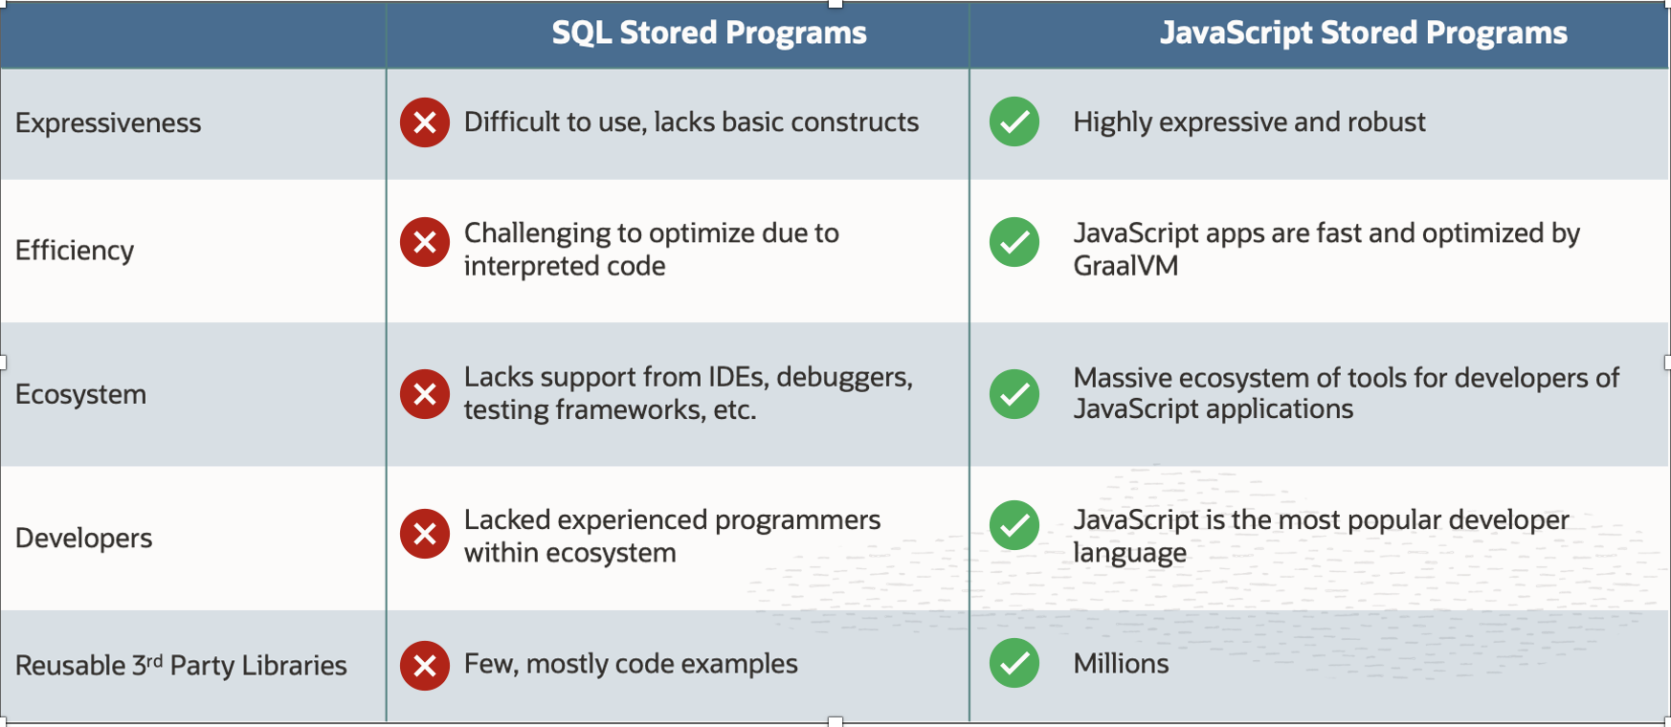
Key takeaways

Slide 34
Resources
MySQL Stored programming
https://dev.mysql.com/doc/refman/9.3/en/stored-objects.html
MySQL Javascript store programming
https://dev.mysql.com/doc/refman/9.3/en/stored-routines-js.html
MySQL JavaScript examples from manual
https://dev.mysql.com/doc/refman/9.3/en/srjs-examples.html
MySQL JavaScript example: MySQL vector operations
https://lefred.be/content/mysql-vector-datatype-create-your-operations-part-1/
MySQL JavaScript example: UUID
https://blogs.oracle.com/mysql/post/javascript-support-in-mysql-the-uuid-example

Slide 35

Thank you
Emmanuel COLUSSI
emmanuel.colussi@oracle.com

